Slide 1
Digital Image Processing and Analysis in SDG 8
(Decent Work and
Economic Growth)
Patricia Joanne - 140810160065

Slide 2
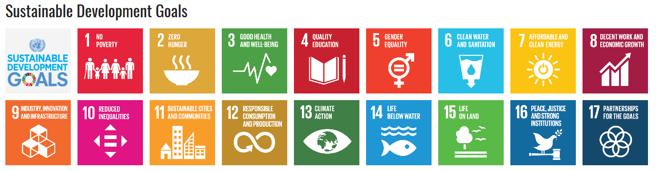
What is SDG?
The Sustainable Development Goals consist 17 global goals set by the United
Nations in 2015 for the year 2030. There are 169 targets total, and each target has
between 1 and 3 indicators used to measure progress toward reaching the targets so there are 232 approved indicators that will measure compliance.
https://en.wikipedia.org/wiki/Sustainable_Development_Goals

Slide 3
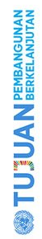
SDG in Indonesia
Source: http://sdgcenter.unpad.ac.id/wp-content/uploads/2018/04/Prof.-Bambang-Brodjonegoro-Tantangan-dan-Strategi-Pelaksanaan-SDGs-di-Indonesia.pdf
Known as TPB
Which stands for “Tujuan Pembangunan Berkelanjutan”
How Indonesia implements SDG
Foreign policy: FREE and ACTIVE
National development agenda: NAWACITA (listed in RPJMN 2015-2019)
Legal basis for SDG: Perpres no. 59 thn 2017 “Pelaksanaan Pencapaian TPB/SDGs” (read here https://www.sdg2030indonesia.org/an-component/media/upload-book/A_Perpres_Nomor_59_Tahun_2017.pdf)
SDG Center in Indonesia
There are in 6 universities, one of them is Padjadjaran University
Indonesia’s SDG official website
Visit https://www.sdg2030indonesia.org

Slide 4
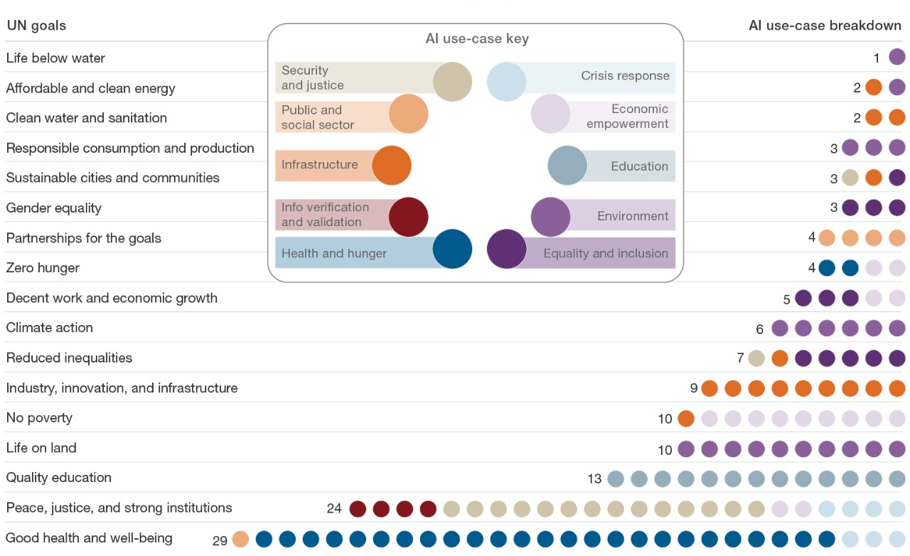
AI used for SDGs
AI can be used in 10 sections which are
explained in the AI use-case
key here.
The SDGs are grouped based on the AI
use-case key.
Source:
McKinsey Global Institute
Analysis

Slide 5
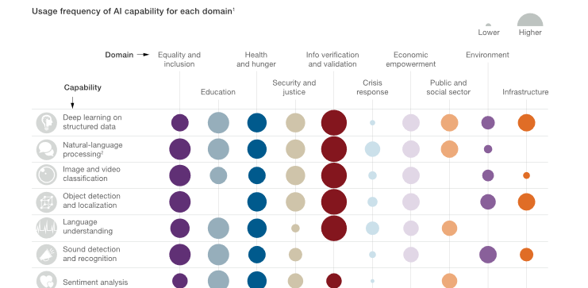
AI used for SDGs
Source: McKinsey Global Institute Analysis

Slide 6
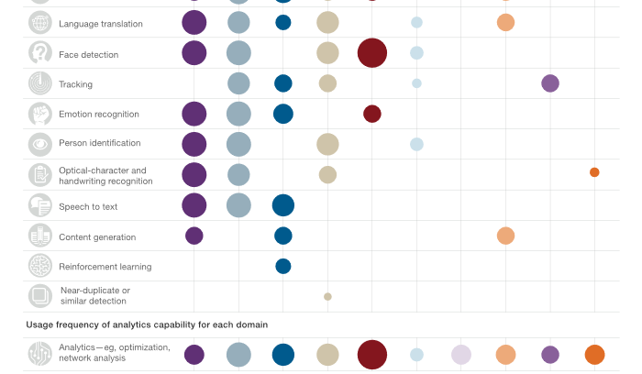
AI used for SDGs
Source: McKinsey Global Institute Analysis

Slide 7


AI used for SDG 8
Based on the previous infographics, AI implementations for SDG 8 are preferably into
“equality and inclusion” and “economic empowerment”

Slide 8



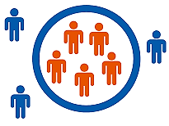
Economic empowerment
Agricultural
quality
and yield
Initiatives for
economic
growth
Labor supply
and demand
matching
Financial
inclusion
ISSUES TYPES OF THE AI USE-CASE KEY (FOCUSED ON SDG 8 ONLY)
(Source: https://www.mckinsey.com/~/media/mckinsey/featured%20insights/artificial%20intelligence/applying%20artificial%20intelligence%20for
%20social%20good/mgi-applying-ai-for-social-good-discussion-paper-dec-2018.ashx)
Equality and inclusion
Accessibility
and disabilities
Marginalized
communities
Exploitation

Slide 9
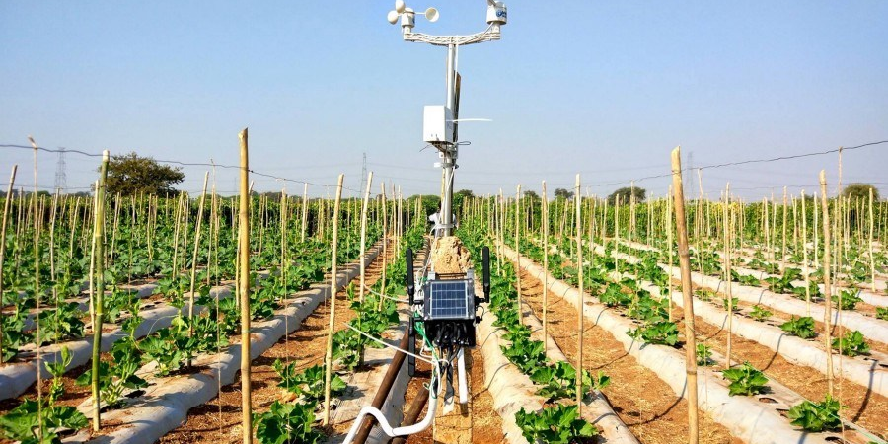
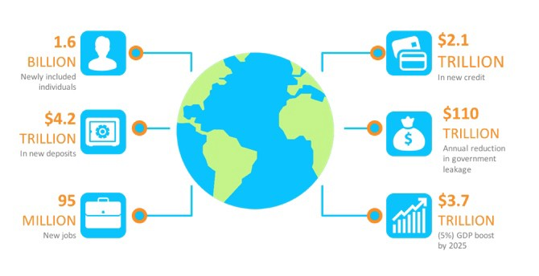
From the 4 issues types, agriculture is the most
developed right now using deep learning and IoT [1].
Financial inclusion is also in development in Africa [2].
[1] https://www.mckinsey.com/~/media/mckinsey/featured%20insights/artificial%20intelligence/applying%20artificial%20intelligence%20for%20social%20good/mgi-applying-ai-for-social-good-discussion-paper-dec-2018.ashx
[2] https://medium.com/@gopalsharmadxb/ai-driven-financial-inclusion-for-africa-782eae1ff730
Economic
empowerment
in real life

Slide 10
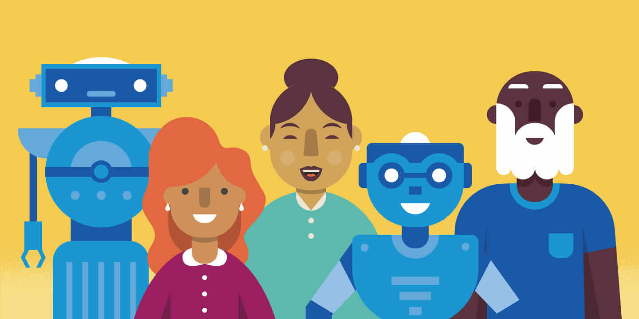
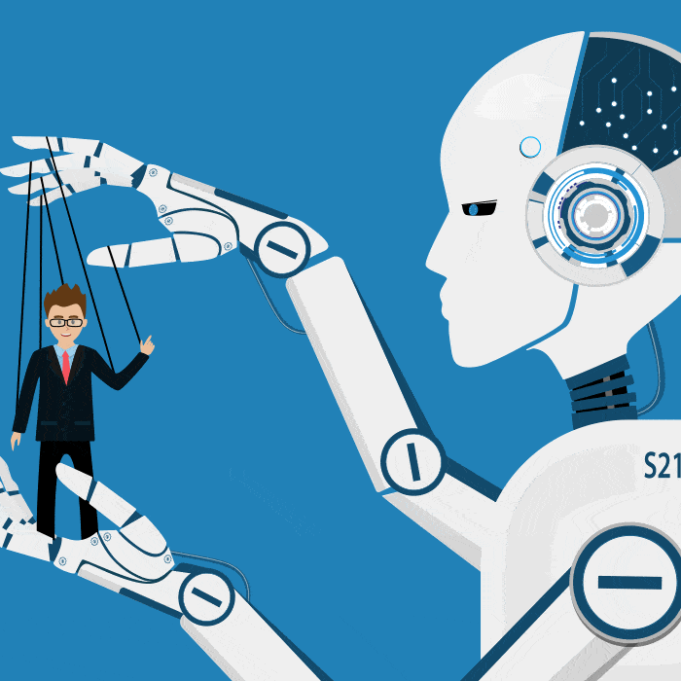
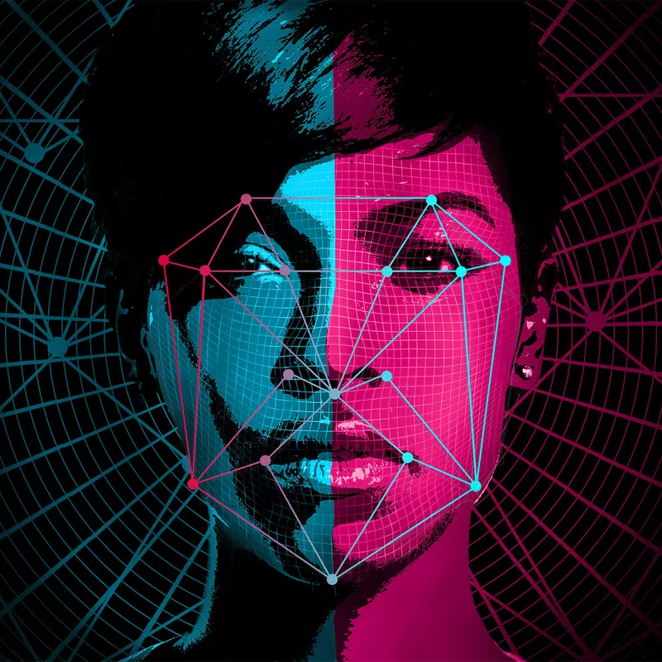
Many solutions in this domain rely most on NLP and
computer vision [1].
AI also prevents racial, age, gender, disability & other discrimination by humans [2].
[1] https://www.mckinsey.com/~/media/mckinsey/featured%20insights/artificial%20intelligence/applying%20artificial%20intelligence%20for%20social%20good/mgi-applying-ai-for-social-good-discussion-paper-dec-2018.ashx
[2] http://diversity.ai/
Equality and
inclusion
in real life

Slide 11

Digital Image
Processing & Analysis
Definition
The use of computer algorithms to perform image processing and analysis on digital images
Difference with Analog Image Processing
The output of analog image processing is always an image. However, the output of digital image processing may be an image or some features and characteristics associated with that image.
The correlation with AI
AI, especially machine learning and neural networks, can solve image processing tasks (Source: https://www.apriorit.com/dev-blog/599-ai-for-image-processing)

Slide 12
Image Processing & Analysis in SDG 8
Issues of SDG 8 that can be solved with image processing & analysis, supported by AI.
Already well-developed in the real life
Farmer can detect which crops can be harvested, need pesticide, or need water by combining image processing and machine learning [1].
Doctors and nurses can use 3D images to perform surgeries of delicate areas like inside veins [2].
Disabilities can work like other people using 3D navigations [2].
Drones to shoot streets and show real-time images of traffic conditions to help people who are in the way to work bypass congestions [2].
Satellite images show economic life in countries [3].
[1] https://www.rsipvision.com/ image-processing-for-precise-agriculture
[2] https://economictimes.indiatimes.com/tech/software/how-image-processing-will-change-your-world-in-future/articleshow/10394958.cms
[3] https://www.bloomberg.com/news/features/2015-07-08/satellite-images-show-economies-growing-and-shrinking-in-real-time

Slide 13
Image Processing & Analysis in SDG 8
Issues of SDG 8 that can be solved with image processing & analysis, supported by AI.
Ideas that are not yet in real life or developed in progress
Basically it’s hard to link economic growth to digital image processing so these ideas below are only for decent work problems which are when people have decent works, the economy will grow.
There should be a system to record person’s persona such as face, body, fingerprint, etc. to help police solving crimes.
3D reconstruction for seeing what happened in the past to help some professions like police (crime scene), scientist, etc.
Understanding human cells or virus activities to help doctor learning.
Face recognition for bank account security.

Slide 14
THANK YOU
“We need economic growth, yes, but growth can be jobless, so a sustainable development framework for employment must include a job creation strategy.”
–Sharan Burrow

